Slide 1

ISO 9001:2015
ESIS individual assignment
IT20618872-Thisitha K.L.D

Slide 2

CONTENTS
1. What is ISO9001:2015
2. Importance of ISO9001:2015

Slide 3

What is ISO9001:2015
framework for improving quality.
meet the requirements and expectations of customers.

Slide 4

Importance of ISO9001:2015
Quality products
Enhanced efficiency
Continuous improvements

Slide 5
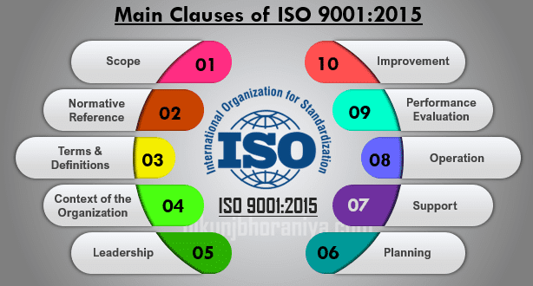
10 clauses of ISO9001:2015
Scope
Normative references
Terms and Definitions
Context of the organization
Leadership
Planning
Support
Operation
Performance evaluation
improvement

Slide 6
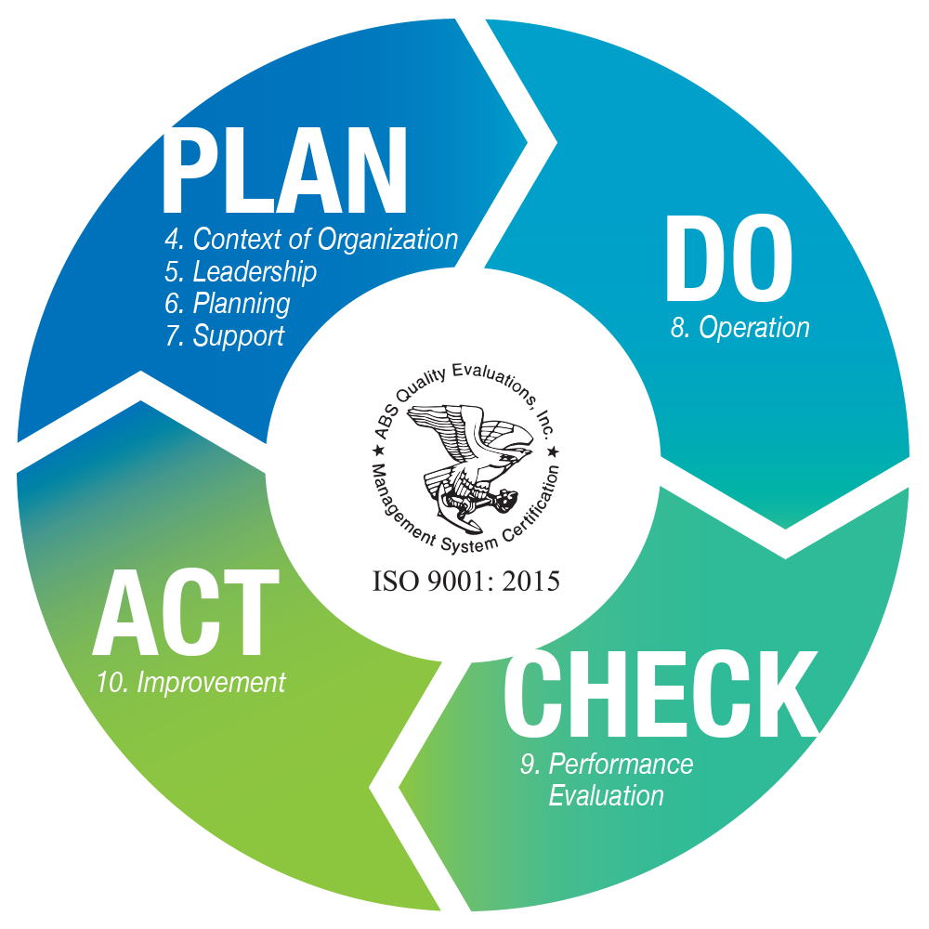
Plan-do-check-act cycle

Slide 7
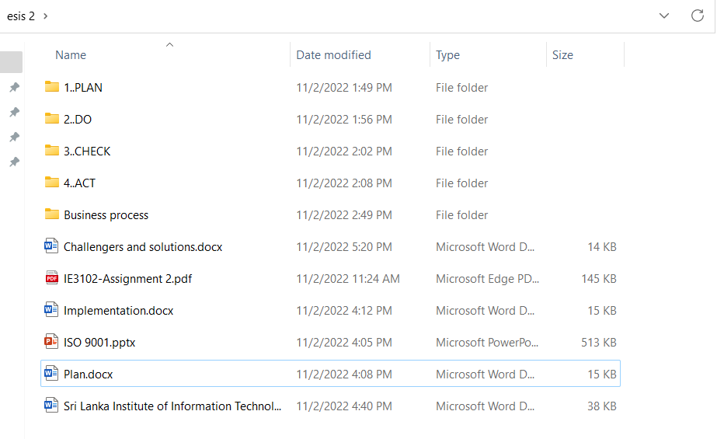
toolkit

Slide 8
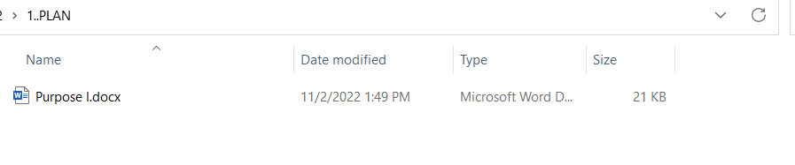
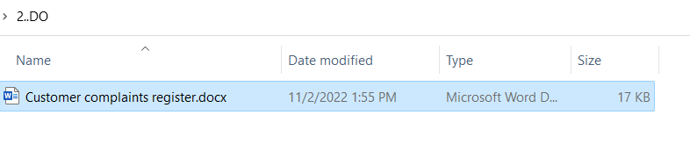
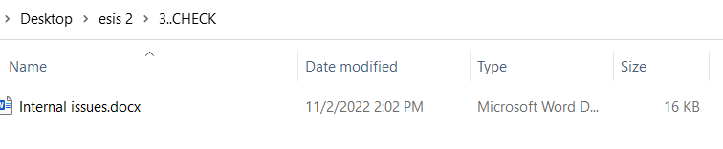
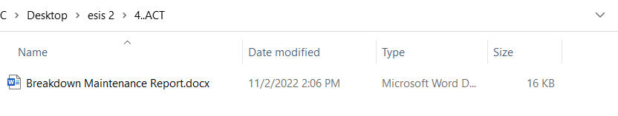

Slide 9

Issues and challenges
ISO 9001 Guidelines Are too Inflexible
Documentation

Slide 10

Thank you

